Slide 1
Item Response Theory and Computerized Adaptive Testing
Hands-on Workshop, day 2
John Rust, jnr24@cam.ac.uk
Iva Cek, ic274@cam.ac.uk
Luning Sun, ls523@cam.ac.uk
Michal Kosinski, mk583@cam.ac.uk
www.psychometrics.cam.ac.uk
Notes:
Add a doorframe example

Slide 2
Goals
General understanding of IRT and CAT concepts
No equations!
Acquire necessary technical skills (R)
Tomorrow: Build your own IRT-based CAT tests using Concerto

Slide 3
Introduction to IRT
Some materials and examples come from the ESRC RDI in Applied Psychometrics run by:
Anna Brown (University of Cambridge)
Jan Böhnke (University of Trier)
Tim Croudace (University of Cambridge)

Slide 4
Tests are not 100% accurate
Measurement error
Test as a series of small experiments

Slide 5
Classical Test Theory
Observed Test Score = True Score + random error
Item difficulty and discrimination
Reliability
Limitations:
Single reliability value for the entire test and all participants
Scores are item dependent
Item stats are sample dependent
Bias towards average difficulty in test construction

Slide 6
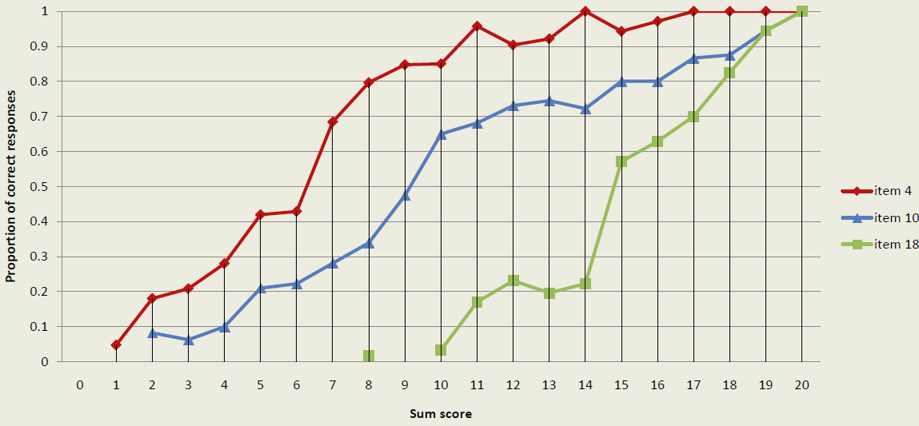
1
Probability of getting item right
Measured concept (ability)
Ratio of correct responses to items on different level of total score

Slide 7
Item Response Function
Please mind that those and many other graphs presented here are just Excel based
mock-ups created for the presentation purposes rather than representing actual data
Binary items
Probability of getting item right
1
Inattention
Discrimination (slope)
Parameters:
Difficulty
Discrimination
Guessing
Inattention
Models:
1 Parameter
2 Parameter
3 Parameter
4 Parameter
unfolding
Difficulty
Guessing
Measured concept (theta)

Slide 8
One-Parameter Logistic Model/Rasch Model (1PL)
7 items of varying difficulty (b)

Slide 9
Two-Parameter Logistic Model (2PL)
5 items of varying difficulty (b) and discrimination (a)
Notes:
ICCs may cross over each other
- slope defines how rapidly probabilities change with trait level

Slide 10
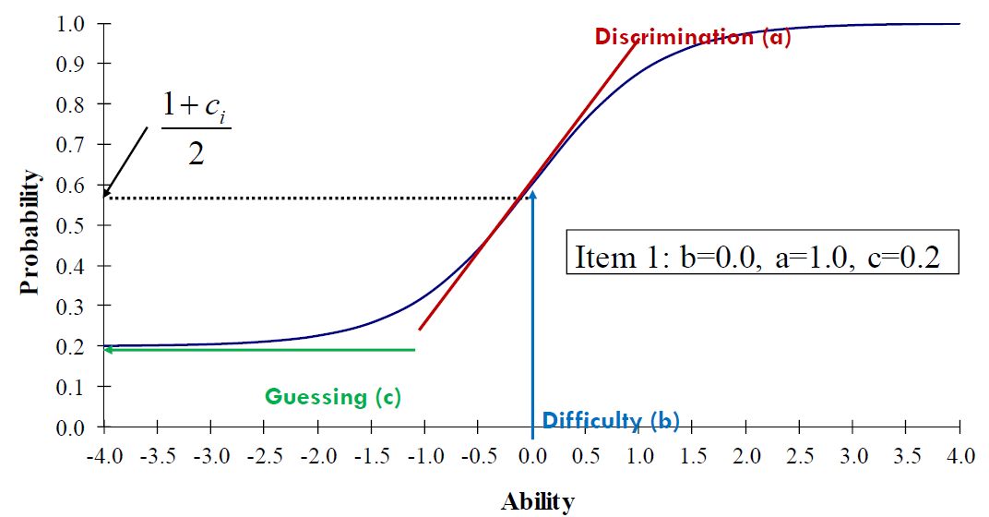
Three-Parameter Model (3PL)
One item showing the guessing parameter (c)
Notes:
When C=o, the three parameter model is equal to the 2pl model
Rule of thumb is that the more parameters we want to estimate the more participants we need. If there are sample size limitations, better to use a 1PL model and use 2PL or 3PL as diagnostic tools
Data requirements (only guidelines)1 parameter –n>200
2 parameter –n>600
3 parameter –n>1000

Slide 11
Option Response Function
Binary items
Correct response
Incorrect response
Probability of Correct + Probability of Incorrect = 1

Slide 12
Graded Model (example of a model with polytomous items – e.g. Likert Scales)
“I experience dizziness when I first wake up in the morning”
(0) “never”
“rarely”
“some of the time”
“most of the time”
“almost always”
Category Response Curves for an item representing the probability of
responding in a particular category conditional on trait level

Slide 13
Fisher Information Function

Slide 14
(Fisher) Test Information Function
Three items

Slide 15
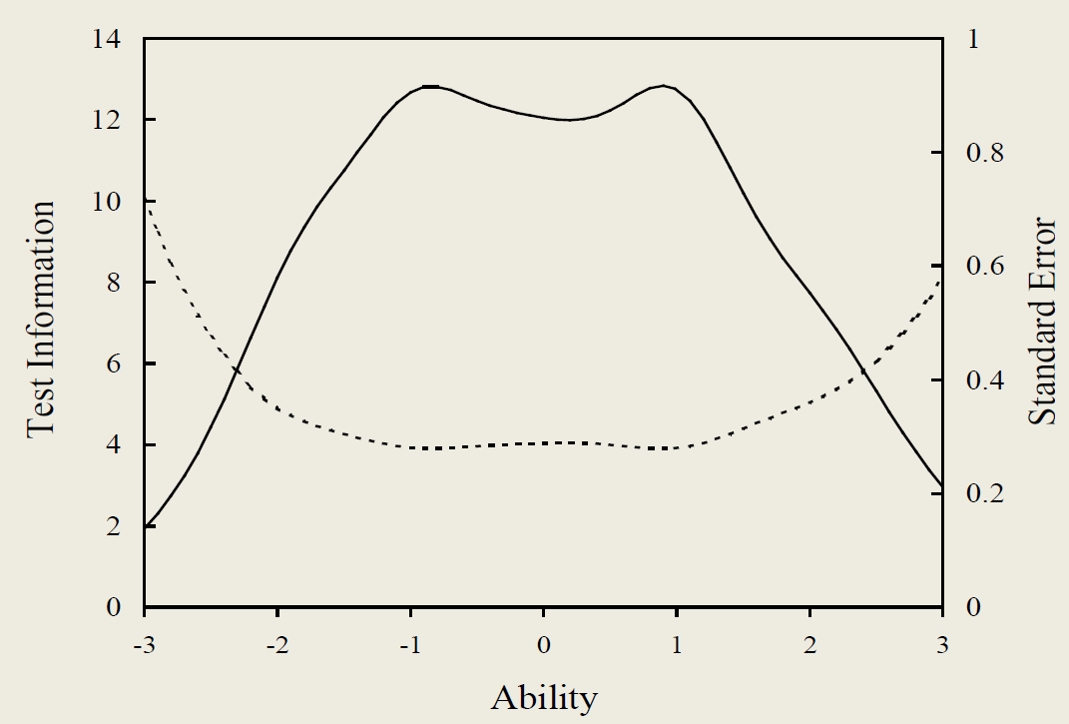
TIF and Standard Error (SE)
Error of measurement inversely related to information
Standard error (SE) is an estimate of measurement precision at a given theta
Notes:
SE is index of variability (i.e. The standard deviation) of an estimator with respect to the parameter that it is estimating. The larger the value of the SE the greater the error and less certain we are about the parameter’s value.

Slide 16
Scoring
Test:
Normal distribution
q1 – Correct
q2 – Correct
q3 - Incorrect
Most likely score
Most likely score
Most likely score

Slide 17
Classical Test Theory vs. Item Response Theory
 | Classical | IRT
Modelling / Interpretation | Total score | Individual items (questions)
Accuracy / Information | Same for all participants and scores | Estimated for each score / participant
Adaptivity | Virtually not possible | Possible
Score | Depends on the items | Item independent
Item Parameters | Sample dependent | Sample independent
Preferred items | Average difficulty | Any difficulty
Notes:
- IRT provides information function and standard errors that describe the
precision of a test as an instrument for establishing test-taker ability across the latent trait scale
estimation of examinee ability in IRT is item independent, and similarly, the estimation of item attributes is sample independent. Hence, we can assert that the inferences made by IRT are concerned with the instrument rather than the test scores.
- IRT both person and item attributes are taken into consideration when conducting item calibration and person proficiency estimation
In contrast with CTT, in IRT reliability variesfor different levels of the latent trait

Slide 18
Why use Item Response Theory?
Reliability for each examinee / latent trait level
Modelling on the item level
Examinee / Item parameters on the same scale
Examinee / Item parameters invariance
Score is item independent
Adaptive testing
Also, test development is: cheaper and faster!

Slide 19
IRT in R
ltm package
Suggested Resource:
Computerised Adaptive Testing: The State of the Art (November 2010)
Dr Philipp Doebler of the University of Munster describes the latest thinking on adaptivity in psychometric testing to an audience of psychologists.

Slide 20
“Mobility” Survey
A rural subsample of 8445 women from the Bangladesh Fertility Survey of 1989 (Huqand Cleland, 1990).
The dimension of interest is women’s mobility and social freedom.
Described in: Bartholomew, D., Steel, F., Moustaki, I. and Galbraith, J. (2002) The Analysis and Interpretation of Multivariate Data for Social Scientists. London: Chapman and Hall.
Data is available within R software package “ltm”

Slide 21
“Mobility” Survey
Women were asked whether they could engage in the following activities alone (1 = yes, 0 = no):
Go to any part of the village/town/city.
Go outside the village/town/city.
Talk to a man you do not know.
Go to a cinema/cultural show.
Go shopping.
Go to a cooperative/mothers' club/other club.
Attend a political meeting.
Go to a health centre/hospital.

Slide 22
ltm package
install.packages("ltm")
require(ltm)
help(ltm)
head(Mobility)
my1pl<-rasch(Mobility)
my1pl
summary(my1pl)
plot(my1pl, type = "ICC")
plot(my1pl, type = "IIC", items=0)
Notes:
AIC = 2*#params-2*log.lik
My1pl for mobility …. AIC=2*9-2*-23416.48
BIC = #params*log(#cases)-2*log.like = 9*log(8445)-2*(-23416.48)

Slide 23
ltm package
## rasch
myrasch<-rasch(Mobility, cbind(9,1))
my2pl <- ltm(Mobility ~ z1)
anova(my1pl, my2pl)
(the smaller the better!)
Now plot ICC and IIC for 2pl model.
Notes:
AIC = 2*#params-2*log.lik
My1pl for mobility …. AIC=2*9-2*-23416.48
BIC = #params*log(#cases)-2*log.like = 9*log(8445)-2*(-23416.48)

Slide 24
ltm package – scoring
resp<-matrix(c(1,1,1,1,0,1,0,1), nrow=1)
factor.scores(my2pl, method="EAP", resp.patterns=resp)
EXPLAIN: “$” addressing
theta = dataCAT$score.dat$z1
sem = dataCAT$score.dat$se.z1
mobIRT <- factor.scores(my2pl, resp.patterns=Mobility, method="EAP")
head(mobIRT$score.dat)

Slide 25
Compare IRT and CTT scores
CTT_scores <- rowSums(Mobility)
IRT_scores <- mobIRT$score.dat$z1
plot(IRT_scores, CTT_scores)
#Plot the standard error and scores
IRT_errors <- mobIRT$score.dat$se.z1
plot(IRT_scores, IRT_errors, type="p")

Slide 26
Model FIT
Checking model fit:
margins(my1pl)
GoF.rasch(my1pl, B=199)
Notes:
GOF – compare exp with obs freq accountin for the fact that for many obs/exp < 5

Slide 27
Introduction to CAT
Very brief

Slide 28
Computerized Adaptive Testing
Standard test is likely to contain questions that are too easy and/or too difficult
Adaptively adjusting to the level of the test to this of participant:
Increases the accuracy
Saves time / money
Prevents frustration

Slide 29
Example of CAT
Start the test:
Ask first question, e.g. of medium difficulty
Correct!
Score it
Select next item with a difficulty around the most likely score (or with the max information)
And so on…. Until the stopping rule is reached
Incorrect response
Correct response
Normal distribution
Difficulty
Most likely score

Slide 30
Elements of CAT
IRT model
Item bank and calibration
Starting point
Item selection algorithm (CAT algorithm)
Scoring-on-the-fly method
Termination rules
Item bank protection / overexposure
Content Balancing

Slide 31
Classic approaches to item selection
Maximum Fisher information (MFI)
Obtain a current ability estimate
Select next item that maximizes information around the current ability estimate
Urry’s method (in 1PL equals MFI)
Obtain a current ability estimate
Select next item with a difficulty closest to the current one
Other methods:
Minimum expected posterior variance (MEPV)
Maximum likelihood weighted information (MLWI)
Maximum posterior weighted information (MPWI)
Maximum expected information (MEI)

Slide 32
Examples of item overexposure prevention
Randomesque approach (Kingsbury & Zara, 1989)
Select >1 next best item
Randomly choose from this set
Embargo on overexposed items
Location / Name / IP address rules
Kingsbury, G. G., and Zara, A. R. (1989). Procedures for selecting items for computerized adaptive tests. Applied Measurement in Education, 2, 359-375.

Slide 33
Content Balancing
Ascertain that all subgroups of items are used equally

Slide 34
CAT in R
catR package
Suggested Resource:
Computerised Adaptive Testing: The State of the Art (November 2010)
Dr Philipp Doebler of the University of Munster describes the latest thinking on adaptivity in psychometric testing to an audience of psychologists.

Slide 35
CAT using ltm
responses<-matrix(rep(NA, 8), nrow=1) ##create an empty response matrix
items<-4 ### indicate administered items
responses[1,4]<-1 #### provide responses
## compute the score
dataCAT <- factor.scores(my2pl, method="EAP", resp.patterns=responses)
theta = dataCAT$score.dat$z1
sem = dataCAT$score.dat$se.z1
## create the information matrix
item_info_mat = plot(my2pl, type = "IIC", plot = F)
## select the theta level in the in the info. matrix
row<-order(abs(theta - item_info_mat[,1]))[1]
info<-item_info_mat[row,-1]
sorted_items<-order(info, decreasing=T)
sorted_items[is.na(match(sorted_items, items))][1]

Slide 36
catR
install.packages("catR")
require(catR)
c<-coef(my2pl)
itemBank <- cbind(c[,2], c[,1], 0, 1)
catBank<-createItemBank(itemBank, model="2pl")
catBank
catBank$itemPar
plot(catBank$infoTab[,1])
plot(my2pl, type = "IIC", items=1)

Slide 37
catR
Choose the item to start with:
max info around average?
plot(my2pl, type = "IIC")
plot(my2pl, type = "IIC", items=4)
Random one?

Slide 38
catR
items_administered<-c(4)
responses<-c(1)
it<-itemBank[items_administered, 1:4,drop=F ]
theta<-thetaEst(it, responses)
q<-nextItem(catBank, theta,out=items_administered)
q$item

Slide 39
$$p\left(θ\right)=guessing+\left(1−guessing\right)\frac{1}{1+e^{−discrimination(θ−difficulty)}}$$
Assumption of Local Independence – A response to a question is independent of responses to other questions in a scale after controlling for the latent trait (construct) measured by the scale.
Assumption of Unidimensionality - the set of questions are measuring a single continuous latent variable (construct).
under the assumption of a normal θ distribution, to the biserial item-test correlation ρ (Linden & Hambleton, 1997). For item i the relationship is:
Difficulty = p/sqrt(1-p)
I = discrimination^2*p(correct)*(p(incorrect) (2pl)
Standard error= 1/sqrt(information)
Notes:
t<--400:400/100
p<-1/1+ln(1)^-(t-0)
plot(t,p)
plot(t,dnorm(t)*p)
t[order(dnorm(t)*p, decreasing=T)[1]]
thetaEst(it=matrix(c(1,0,0,1), nrow=1),1)
p<-1/(1+exp(-1.5*(theta-2)))

